Slide 1
Planning with Temporal Logic
April 25, 2016
Mark Chodas, Marlyse Reeves, Ellie Simonson, Ben Reynolds, Navi Tansaraviput
Notes:
Ben

Slide 2
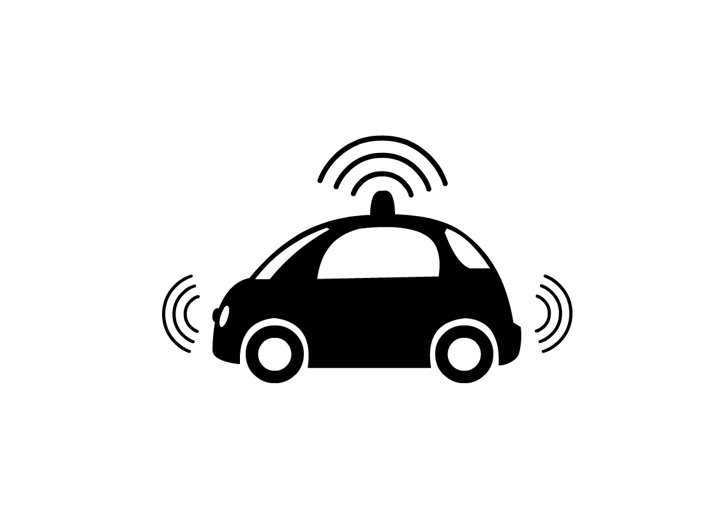
Motivation
Consider a self-driving car…
Regardless of our destination, we also want to make sure we always follow the rules of the road
Notes:
We can express a goal condition
But what about ensuring that we obey the rules of the road (regardless of what other goals and destinations we have)?
How would we handle traffic lights?
Consider a self-driving car:
- we’ve seen before in classical planners how to give it goal conditions to reach, for example: given a graph of connected city-blocks, find the path to the goal that picks up certain passengers and reaches their destination (perhaps while minimizing time or fuel used).
There may be many valid paths to reach this goal state, but what about other requirements for the self-driving car’s path? It should always follow the rules of the road.
For example, how to handle traffic lights?
In english, how would you describe the correct behavior for a self-driving car at a traffic light?
If the light is green, we can keep driving
If the light is yellow, we should slow down and stop
If the light is red, we should stop
… until the light turns green, then we can start again
GREEN -> DRIVE
ALWAYS( RED -> (STOP UNTIL GREEN) )

Slide 3


Motivation
Notes:
We can express a goal condition
But what about ensuring that we obey the rules of the road (regardless of what other goals and destinations we have)?
How would we handle traffic lights?
Consider a self-driving car:
- we’ve seen before in classical planners how to give it goal conditions to reach, for example: given a graph of connected city-blocks, find the path to the goal that picks up certain passengers and reaches their destination (perhaps while minimizing time or fuel used).
There may be many valid paths to reach this goal state, but what about other requirements for the self-driving car’s path? It should always follow the rules of the road.
For example, how to handle traffic lights?
In english, how would you describe the correct behavior for a self-driving car at a traffic light?
If the light is green, we can keep driving
If the light is yellow, we should slow down and stop
If the light is red, we should stop
… until the light turns green, then we can start again
GREEN -> DRIVE
ALWAYS( RED -> (STOP UNTIL GREEN) )

Slide 4


Motivation
Notes:
also tie in the “always at some point in the future we should visit a gas station”
We can express a goal condition
But what about ensuring that we obey the rules of the road (regardless of what other goals and destinations we have)?
How would we handle traffic lights?
Consider a self-driving car:
- we’ve seen before in classical planners how to give it goal conditions to reach, for example: given a graph of connected city-blocks, find the path to the goal that picks up certain passengers and reaches their destination (perhaps while minimizing time or fuel used).
There may be many valid paths to reach this goal state, but what about other requirements for the self-driving car’s path? It should always follow the rules of the road.
For example, how to handle traffic lights?
In english, how would you describe the correct behavior for a self-driving car at a traffic light?
If the light is green, we can keep driving
If the light is yellow, we should slow down and stop
If the light is red, we should stop
… until the light turns green, then we can start again
GREEN -> DRIVE
ALWAYS( RED -> (STOP UNTIL GREEN) )
work being done in George Pappas’ group

Slide 5
Key Takeaways
Modeling temporally-extended goals with linear temporal logic (LTL)
Modeling preferences between alternative plans

Slide 6
Outline
Introduction to Linear Temporal Logic
Why use Linear Temporal Logic?
Linear Temporal Logic Operators
Example LTL Problems
Applications to Planning
Planning with Preferences
Expressing Preferences
Planning in LPP
Notes:
LPP is a language to express temporal preferences for planning

Slide 7
Linear Temporal Logic

Slide 8
Temporal Logic
Formalism for specifying properties of systems that vary with time
Notes:
Temporal properties defined over a set of states, rather than a single goal state

Slide 9
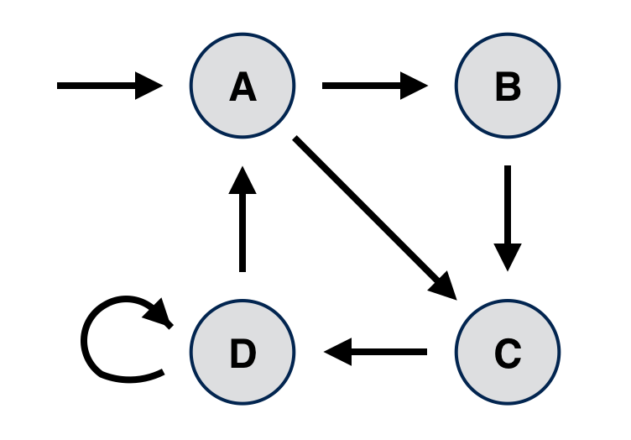
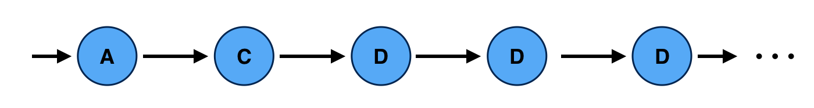
Temporal Logic
Systems proceed through a sequence of discrete states
Notes:
e.g. the components from the last pset (warp reactor, valves), or the position of a robot in a gridworld
a “trace” or a “timeline” is the sequence of states you get when you actually execute a system
a trace/timeline can be infinitely long

Slide 10
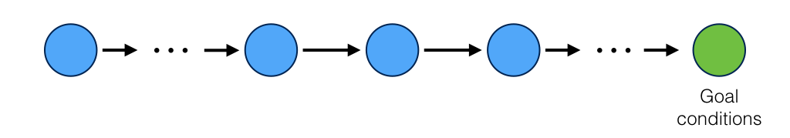
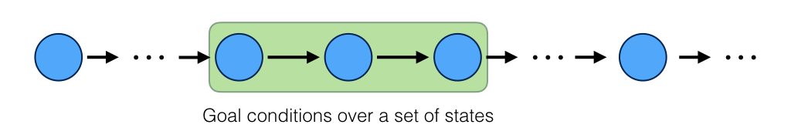
Why Temporal Logic?
Previously our planning algorithms have used propositional logic to specify goals dealing with a single state at a single point in time
Temporal logic allows these goals to be specified over a sequence of states
Notes:
for example, (ship at levinia) and (people saved)
temporal logic, in general, allows us to reason about propositions qualified in terms of time
LTL is a specific type of temporal logic that deals with linear time (rather than branching time, e.g. CTL*)

Slide 11
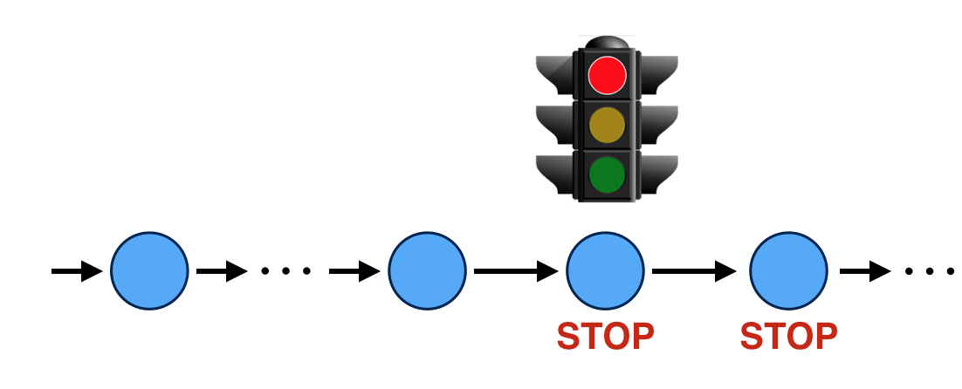
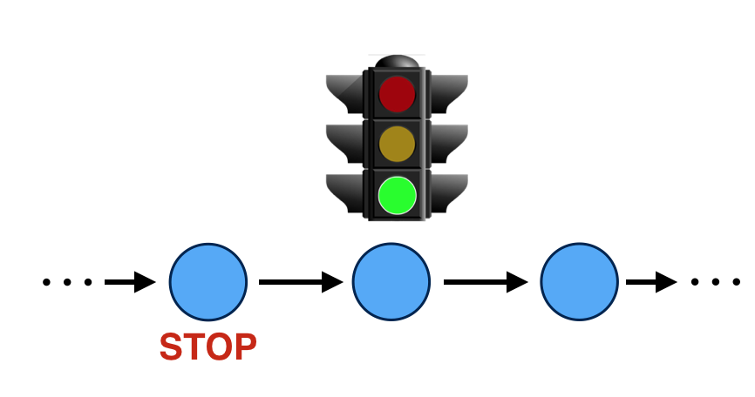
Why Temporal Logic?
What if the problem requires a condition to:
Be met until another condition is met...
For example: red implies (stop until green)

Slide 12
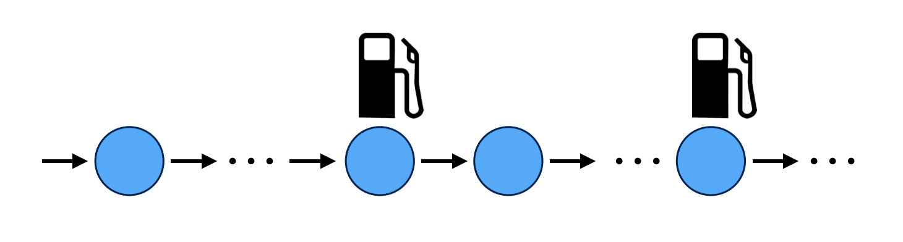
Why Temporal Logic?
What if the problem requires a condition to:
Always eventually be met
For example, always have some point in the future when you visit a gas station

Slide 13
Temporal Logic
Branching vs linear time
Linear time
Models physical time
At each time instant, only one of the future behaviors is considered
We can reason about always
Notes:
linear time is sufficient to reason about a particular path that we have chosen, and models physical time
branching time can reason about all possible future paths, things that can possibly happen (but not most appropriate for the applications we’ll be discussing today)
http://delivery.acm.org/10.1145/10000/4999/p151-emerson.pdf?ip=18.189.74.241&id=4999&acc=ACTIVE%20SERVICE&key=7777116298C9657D%2EDE5F786C30E1A3B4%2E4D4702B0C3E38B35%2E4D4702B0C3E38B35&CFID=603906477&CFTOKEN=44981316&__acm__=1461225364_420f8e5ef1edd6c37ca8e68aebdc03e8

Slide 14
Temporal Logic
Branching vs linear time
Branching time
At each time instant, all possible future behaviors are considered
Time may split into alternate courses
We can reason about possibilities
Notes:
There exists a path that satisfies this condition
All paths satisfy this condition
linear time is sufficient to reason about a particular path that we have chosen, and models physical time
branching time can reason about all possible future paths, things that can possibly happen (but not most appropriate for the applications we’ll be discussing today)
http://delivery.acm.org/10.1145/10000/4999/p151-emerson.pdf?ip=18.189.74.241&id=4999&acc=ACTIVE%20SERVICE&key=7777116298C9657D%2EDE5F786C30E1A3B4%2E4D4702B0C3E38B35%2E4D4702B0C3E38B35&CFID=603906477&CFTOKEN=44981316&__acm__=1461225364_420f8e5ef1edd6c37ca8e68aebdc03e8

Slide 15
Temporal Logic
Branching vs linear time
Linear time
Branching time
Notes:
linear time is sufficient to reason about a particular path that we have chosen, and models physical time
branching time can reason about all possible future paths, things that can possibly happen (but not most appropriate for the applications we’ll be discussing today)
http://delivery.acm.org/10.1145/10000/4999/p151-emerson.pdf?ip=18.189.74.241&id=4999&acc=ACTIVE%20SERVICE&key=7777116298C9657D%2EDE5F786C30E1A3B4%2E4D4702B0C3E38B35%2E4D4702B0C3E38B35&CFID=603906477&CFTOKEN=44981316&__acm__=1461225364_420f8e5ef1edd6c37ca8e68aebdc03e8

Slide 16
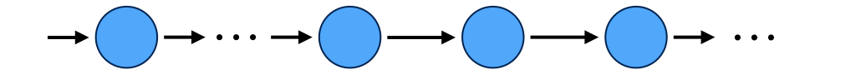
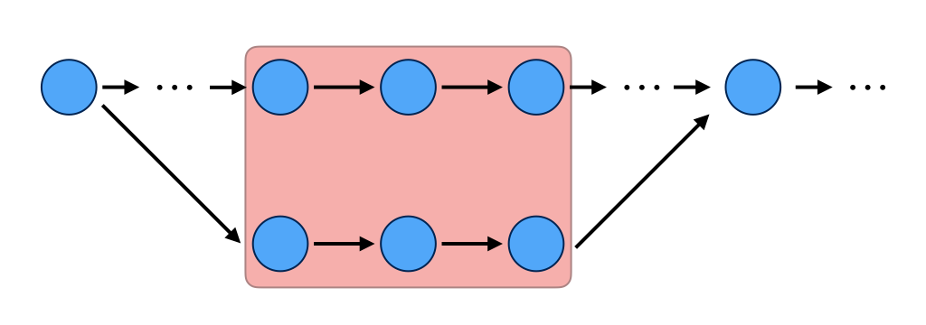
Linear Temporal Logic
Linear time model
Infinite sequences of states
Linear Temporal Logic (LTL) involves:
Forward-looking conditions
Cannot express properties over a set of different paths

Slide 17
Applications of Temporal Logic
Temporal logic is used in:
Verification and Model Checking
Safety and Maintenance
Planning
Notes:
verification: safety and maintenance
model checking: similar

Slide 18
LTL Syntax
LTL formula f := true | p_{i} | f_{i} ∧ f_{j} | ¬ f_{i} | X f_{i} | f_{i} U f_{j}
An LTL formula is built from:
Propositional variables: p, ρ, ϕ, ω etc.
Can be True or False
Notes:
Ellie

Slide 19
LTL Syntax
LTL formula f := true | p_{i} | f_{i} ∧ f_{j} | ¬ f_{i} | X f_{i} | f_{i} U f_{j}
An LTL formula is built from:
Propositional variables: p, ρ, ϕ, ω etc.
Can be True or False
Logical Operators: ¬, ∨, ∧, →, ↔, True, False
Notes:
Ellie

Slide 20
LTL Syntax
LTL formula f := true | p_{i} | f_{i} ∧ f_{j} | ¬ f_{i} | X f_{i} | f_{i} U f_{j}
An LTL formula is built from:
Propositional variables: p, ρ, ϕ, ω etc.
Can be True or False
Logical Operators: ¬, ∨, ∧, →, ↔, True, False
¬ = not
Notes:
Ellie

Slide 21
LTL Syntax
LTL formula f := true | p_{i} | f_{i} ∧ f_{j} | ¬ f_{i} | X f_{i} | f_{i} U f_{j}
An LTL formula is built from:
Propositional variables: p, ρ, ϕ, ω etc.
Can be True or False
Logical Operators: ¬, ∨, ∧, →, ↔, True, False
¬ = not
∨ = or
Notes:
Ellie

Slide 22
LTL Syntax
LTL formula f := true | p_{i} | f_{i} ∧ f_{j} | ¬ f_{i} | X f_{i} | f_{i} U f_{j}
An LTL formula is built from:
Propositional variables: p, ρ, ϕ, ω etc.
Can be True or False
Logical Operators: ¬, ∨, ∧, →, ↔, True, False
¬ = not
∨ = or
∧ = and
Notes:
Ellie

Slide 23
LTL Syntax
LTL formula f := true | p_{i} | f_{i} ∧ f_{j} | ¬ f_{i} | X f_{i} | f_{i} U f_{j}
An LTL formula is built from:
Propositional variables: p, ρ, ϕ, ω etc.
Can be True or False
Logical Operators: ¬, ∨, ∧, →, ↔, True, False
¬ = not
∨ = or
∧ = and
→ = implies
Notes:
Ellie

Slide 24
LTL Syntax
LTL formula f := true | p_{i} | f_{i} ∧ f_{j} | ¬ f_{i} | X f_{i} | f_{i} U f_{j}
An LTL formula is built from:
Propositional variables: p, ρ, ϕ, ω etc.
Can be True or False
Logical Operators: ¬, ∨, ∧, →, ↔, True, False
¬ = not
∨ = or
∧ = and
→ = implies
↔ = if and only if
Notes:
Ellie

Slide 25
LTL Syntax
LTL formula f := true | p_{i} | f_{i} ∧ f_{j} | ¬ f_{i} | X f_{i} | f_{i} U f_{j}
An LTL formula is built from:
Propositional variables: p, ρ, ϕ, ω etc.
Can be True or False
Logical Operators: ¬, ∨, ∧, →, ↔, True, False
¬ = not
∨ = or
∧ = and
→ = implies
↔ = if and only if
True, False
Notes:
Ellie

Slide 26
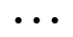
Logical Operator Examples
Logical Operators | Example
true | true
Logical Operators | Example
p = true | R = red light
Notes:
Ellie

Slide 27
Logical Operator Examples
Logical Operators | Example
not, ¬ | ¬ G = green light
Logical Operators | Example
and, ∧ | R ∧ B = gas station
^
Notes:
Ellie

Slide 28
Logical Operator Examples
Logical Operators | Example
or, ∨ | R ∨ G
Or (∨) can be rewritten with and (∧) and not (¬)
R ∨ G = ¬(¬R ∧ ¬G)
Similar process can be done for implies and iff, but we won’t be explaining them due to time constraints
Notes:
Ellie

Slide 29
LTL Syntax
LTL formula f := true | p_{i} | f_{i} ∧ f_{j} | ¬ f_{i} | X f_{i} | f_{i} U f_{j}
An LTL formula is built from:
Propositional variables: p, ρ, ϕ, ω etc.
Can be True or False
Logical Operators: ¬, ∨, ∧, →, ↔, True, False
¬ = not
∨ = or
∧ = and
→ = implies
↔ = if and only if
True, False
Temporal Operators
Notes:
Ellie

Slide 30
Temporal Operators
What are some useful operators we may want to describe our car?

Slide 31
Temporal Operators
The next light to be green

Slide 32
Temporal Operators
The next light to be green
The light will be red until it is green

Slide 33
Temporal Operators
The next light to be green
The light will be red until it is green
The light will eventually, at some point in the future, turn green

Slide 34
Temporal Operators
The light will always be red

Slide 35
Temporal Operators
The light will always be red
The light will be red until the car gets gas and the state after it’s released, the light can be whatever
^

Slide 36
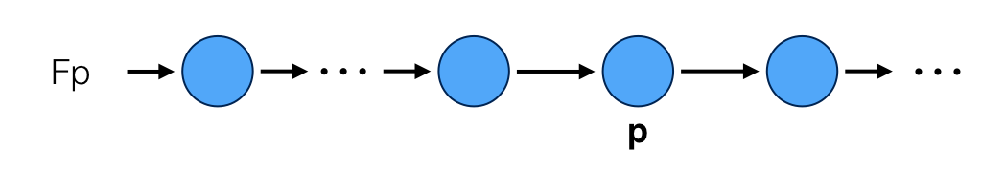
Next
Operator | Textual Operator
neXt | Xρ
Definition: Variable ρ must be true in the next state
Notes:
Ellie

Slide 37
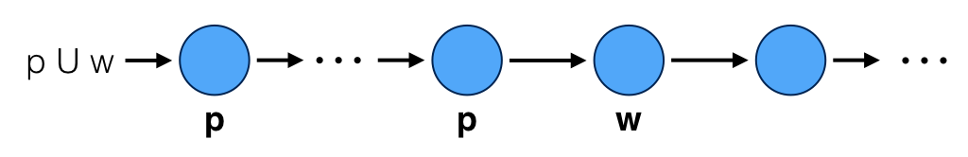
Until
Operator | Textual Operator
Until | ρUω
Definition: Variable ρ must remain true up until the state where variable ω becomes true, at which point ρ becomes unconstrained
Note that ω is required to become true in some future state
Notes:
Ellie

Slide 38
Future
Operator | Textual Operator
Future/Eventually | Fρ
Definition: Variable ρ must become true in some future state
Notes:
Ellie

Slide 39
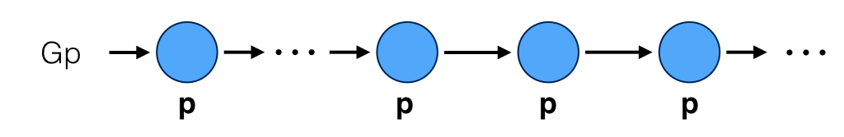
Global
Operator | Textual Operator
Globally | Gρ
Definition: Variable ρ must be true in all future states
Notes:
Ellie

Slide 40
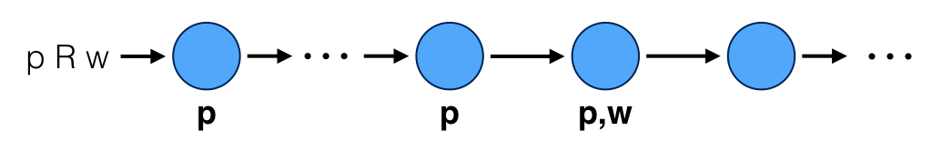
Release
Operator | Textual Operator
Release | ρRω
Definition: Variable ρ must be true up until and including the state where ω becomes true, after which ω is unconstrained. If ρ is not true in any future state, then ω is true in all future states
Different from U in that both ρ and ω are true in one state
Notes:
Ellie

Slide 41
Which describe the other?
Future/Eventually
Release
Globally
?
?
?
≡ True U ρ
≡ ¬F¬ρ
≡ ¬(¬ρ U ¬ω)

Slide 42
Which describe the other?
Future/Eventually
Release
Globally
≡ True U ρ
≡ ¬F¬ρ
≡ ¬(¬ρ U ¬ω)

Slide 43
Temporal Operators (Recap)
Operator | Textual Operator
neXt | Xρ
Until | ρUω
Future/Eventually | Fρ | ≡ True U ρ
Globally | Gρ | ≡ ¬F¬ρ
Release | ρRω | ≡ ¬(¬ρ U ¬ω)
Notes:
Ellie

Slide 44
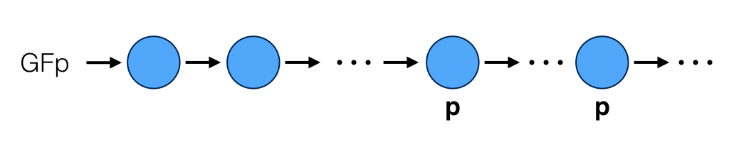
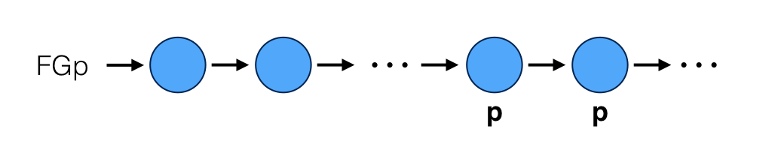
Combination of Operators
Infinitely Often
Eventually Forever
Notes:
Ellie

Slide 45
Example Problem
What are some true statements about this LTL formation?
^
XR
FG
RUG
(RUG)∧(FG)∧(XR)

Slide 46
Expressing Temporal Logic in PDDL
PDDL3 Goal Description
<GD> ::= (at end <GD>) | (always <GD>) | (sometime <GD>) | (within <num> <GD>) | (at-most-once <GD>) | (sometime-after <GD> <GD>) | (sometime-before <GD> <GD>) | (always-within <num> <GD> <GD>) | (hold-during <num> <num> <GD> | …
Notes:
Navi
how to formulate the syntax/semantics of LTL using a classical planner
PDDL 3.0, which is a proposed extension to PDDL 2.2, allows us to express strong and soft constraints and goals using temporal logic
The basic modal operators are as following …
some of the operators maybe familiar to you because they can be used to express hte constraint in STN
where <num> is any numeric literal and “...” includes all existing goal descriptors in previous versions of pddl

Slide 47
Temporal Operators
Operator |  | PDDL3
neXt | Xρ | (within 1 ρ)
Until | ρUω | (always-until ρ ω)
Future | ρFω | (sometime-after ρ ω)
Globally | Gρ | (always ρ)
Release | ρRω | (or (always ω) (always-until ω ρ))
Notes:
Navi

Slide 48
Expressing Temporal Logic in PDDL
The traffic light will turn red in the next state
Xr
t
t+1
(:goal (within 1 (turn red)))
Command Syntax
(within <num> <GD>)
(within <num> φ) would mean that φ must hold within <num> happenings
Notes:
Navi

Slide 49
Expressing Temporal Logic in PDDL
The traffic light will be green until it turns red at which point it will be red forever
(g U r) ∧ (r → Gr)
Notes:
Navi

Slide 50
Expressing Temporal Logic in PDDL
The traffic light will be green until it turns red at which point it will be red forever
(g U r) ∧ (r → Gr)
gUr
...
t0
t1
ti
ti+1
Notes:
Navi

Slide 51
Expressing Temporal Logic in PDDL
The traffic light will be green until it turns red at which point it will be red forever
(g U r) ∧ (r → Gr)
gUr
...
...
t0
t1
ti
ti+1
ti+2
t∞
Notes:
Navi

Slide 52
Expressing Temporal Logic in PDDL
The traffic light will be green until it turns red at which point it will be red forever
(g U r) ∧ (r → Gr)
gUr
...
...
t0
t1
ti
ti+1
ti+2
t∞
(:goal
(and (always-until (turn green) (turn red))
(implies (turn red) (always (turn red)))
))
Notes:
Navi
Marlyse can then show the bridge from LTL to PDDL via Buchi automata

Slide 53
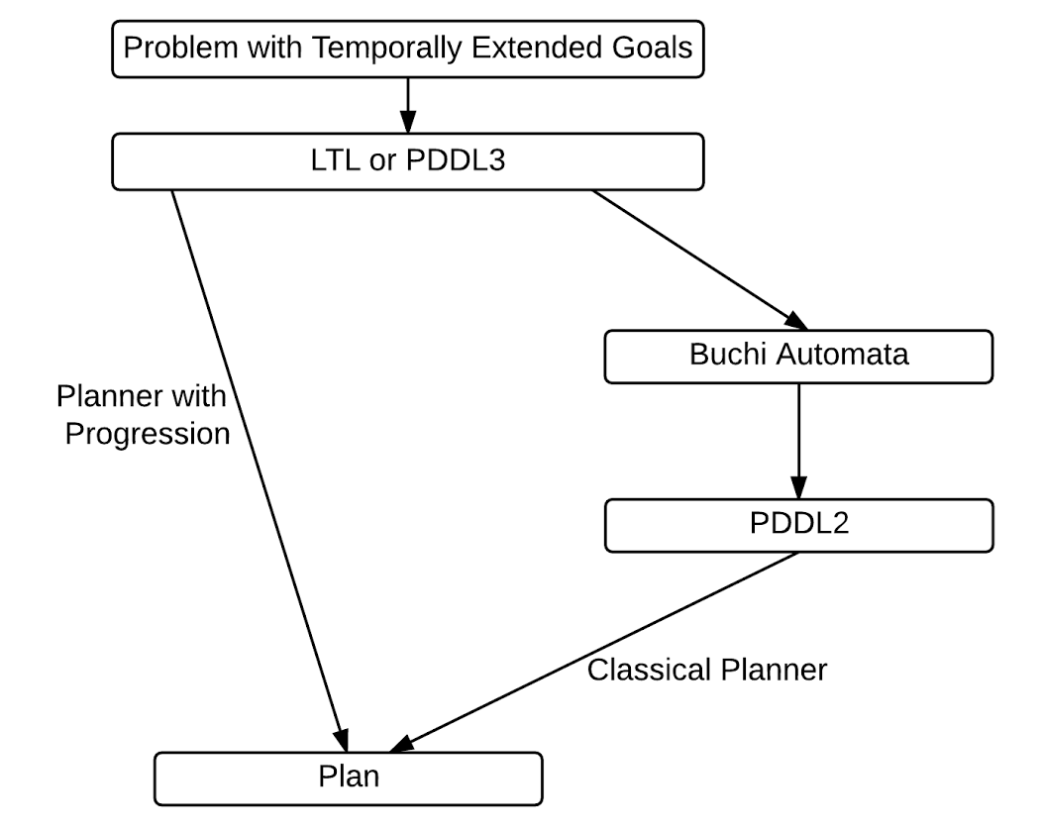
Application to Planning
Notes:
Marlyse,
Difference between goals and preferences
buchi automata to represent the temporally extended goals along with a planning domain
Example, encoding PDDL domain and a Buchi Automata → construct a new domain that can be solved with classical
Temp → if version of LTL can be expressed in the languages ex. PDDL 3, progression, paper by TLPlan Planner University of Toronto

Slide 54
Büchi Automata
Büchi Automata - extension of finite automaton to infinite inputs (words)
A Büchi automaton is 5-tuple <S, s₀, T, F, Σ>
S is a finite set of states
s₀ ∈ S is an initial state
T ⊆ S × Σ → S is a transition relation
F ⊆ S is a set of accepting states
Σ is a finite set of symbols (‘alphabet’)
An infinite sequence of states is accepted iff it visits the accepting state(s) infinitely often
Notes:
Marlyse, non-deterministic, deterministic only returns one state in the transition function, set of initial states, transition relation returns a set, usually more powerful, more often used

Slide 55
Example Büchi Automata
Example: Model a clock
Accepted words:
TickTockTockTickTockTickTickTickTock...
TockTickTockTickTickTockTockTickTock...
Notes:
Marlyse, this is deterministic, non-deterministic not every state need have an outgoing edge for every transition

Slide 56
Example Büchi Automata
Example: Model a clock
Accepted words:
TockTickTickTickTickTickTickTick...
Notes:
Marlyse, this is deterministic, non-deterministic not every state need have an outgoing edge for every transition

Slide 57
Example Büchi Automata
Example: Model a clock
Accepted words:
TockTickTockTickTockTickTockTick...
Notes:
Marlyse, this is deterministic, non-deterministic not every state need have an outgoing edge for every transition
? Ask about accepted word

Slide 58
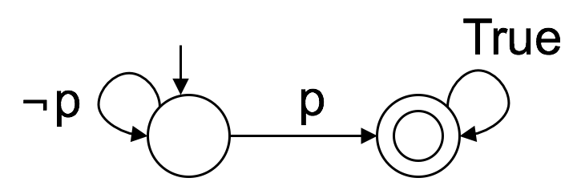
LTL to Büchi Automata
s₀
s₁
neXt?
Future/Eventually?
Globally?
Notes:
Marlyse, both are non-deterministic

Slide 59
LTL to Büchi Automata
Future - Fp ≡ True U p
Accepted word: ¬p ¬p ¬p p p ¬p …
Sequence of states: s₀ s₀ s₀ s₁ s₁ s₁...
s₀
s₁
Notes:
Marlyse, both are non-deterministic

Slide 60
LTL to Büchi Automata
Future - Fp ≡ True U p
Accepted word: ¬p ¬p ¬p p p ¬p …
Sequence of states: s₀ s₀ s₀ s₁ s₁ s₁...
Globally - Gp ≡ ¬F¬p
s₀
s₁
Notes:
Marlyse, both are non-deterministic

Slide 61
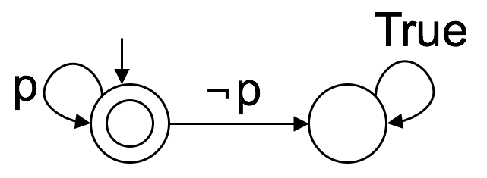
LTL to Büchi Automata
Future - Fp ≡ True U p
Accepted word: ¬p ¬p ¬p p p ¬p …
Sequence of states: s₀ s₀ s₀ s₁ s₁ s₁...
Globally - Gp ≡ ¬F¬p
Accepted word: p p p p p….
Sequence of states: s₀ s₀ s₀ s₀ s₀...
s₀
s₁
s₀
s₁
Notes:
Marlyse, both are non-deterministic

Slide 62
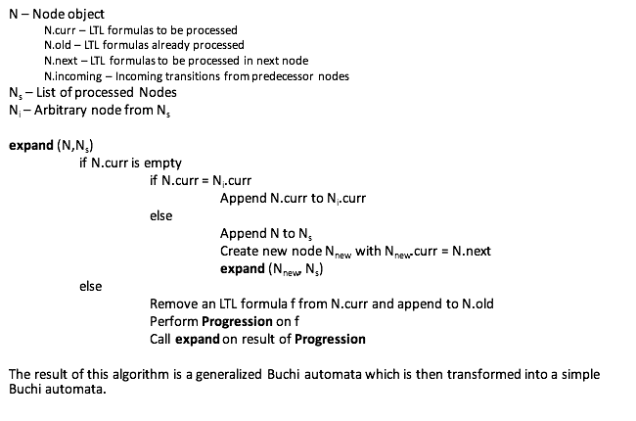
LTL to Büchi Algorithm

Slide 63
Progression Algorithm
progress(f,N, Δt = 1) #Δt is time between successive states
if f contains no temporal qualities:
if N.curr entails f:
f’ = True
else
f’ = False
if f = f₁ ∧ f₂:
progress(f₁, N, Δt) ∧ progress(f₂, N, Δt)
if f = Xf₁:
N.next.append(f₁)
if f = f₁ U_{[a,b]} f₂: #[a,b] is a time interval that could be infinite
if b < a:
f’ = False
else if 0 ∈ [a,b]: progress(f₂, N, Δt) ∨ (progress(f₁,N, Δt) ∧ N.next.append(f₁ U_{[a,b] - Δt} f))
else
progress(f₁,N, Δt) ∧ N.next.append(f₁ U_{[a,b] - Δt} f)

Slide 64
Büchi Automata to PDDL2
Büchi states are not equivalent to PDDL2 states. Consider:
FutureGlobally - FGp

Slide 65
Büchi Automata to PDDL2
Büchi states are not equivalent to PDDL2 states. Consider:
FutureGlobally - FGp
Two ways to transform temporally extended goals to PDDL2:
Create new actions that encapsulate the allowable transitions in each state
Notes:
For example, lets say

Slide 66
Büchi Automata to PDDL2
Büchi states are not equivalent to PDDL2 states. Consider:
FutureGlobally - FGp
Two ways to transform temporally extended goals to PDDL2:
Create new actions that encapsulate the allowable transitions in each state
Introduce derived predicates
Do not depend on the actions
Used to determine which state the planner is in
Goal of the planner is to move from initial state to any accepting state
Notes:
For example, lets say

Slide 67
Planning with Preferences
Notes:
Mark

Slide 68
Preference Based Planning
Classical Planning Problem
problem := (S, s₀ , A, G)
S - set of states s₀ - initial state A - set of operators G - set of goal states
Preference-based Planning Problem
problem := (S, s₀ , A, G, R)
R is a partial or total relation expressing preferences (≼) between plans
Preferences express properties of the plan that are desired but not required
Notes:
Mark
Explain why it could be partial or total

Slide 69
Preference Expression Languages
Quantitative - assign numeric values to plans to compare them
Markov Decision Processes (MDP’s)
Find preferred policy using a reward function over conditional plans
PDDL3
Preferences expressed through reward function based on satisfying/violating logical formulas on the plan
Qualitative - relations compare plans based on properties of the plans that need not be numeric
Ranked Knowledge Bases
Plan properties are ranked with preferred formulas ranked higher
Temporally Extended Preferences
Use LTL to express plan properties that are then ranked
Quantitative languages imply total comparibility while qualitative languages may allow incomparability
Notes:
Mark
Quantitative - always total
Qualitative - can be partial → most expressive languages use a modified version of LTL, examples to follow
How much to talk about each of these??

Slide 70
Expressing Preferences in PDDL3
Syntax for modeling preferences:
(preference [name] <GD>) - label for fluents that represent preferences
is-violated - function that returns the number of times the preference was not satisfied in the plan
Example:
Traffic light is green until it turns red
(preference gUr
(always-until(turn green) (turn red)))
Plan tries to not violate any preferred fluents
(metric minimize (is-violated gUr))
Notes:
Mark

Slide 71
LPP Language Overview
LPP is a quantitative language to express temporal preferences for planning
Preferences between different temporal goals can be expressed along with the strength of preference
i.e. Goal A is preferred twice as much as Goal B
LPP is an extension of an older language PP
Preference formulas in LPP are constructed hierarchically
See Bienvenu, Meghyn, Christian Fritz, and Sheila A. McIlraith. "Planning with Qualitative Temporal Preferences." KR 6 (2006): 134-144.
Notes:
Mark

Slide 72
Constructing a Preference Formula
Basic Desire Formula (BDFs)
express temporally extended propositions
At some point, will cook
b₁=F(cook)
At some point, will order takeout
b₂=F(orderTakeout)
At some point, will eat spaghetti
b₃=F(eatSpaghetti)
At some point, will eat pizza
b₄=F(eatPizza)
Notes:
Mark

Slide 73
Constructing a Preference Formula
Atomic Preference Formulas (APFs)
express preferences between BDFs
In this example, weights associated with each BDF define preferences
Lower weight is preferred
Prefer to cook over ordering takeout
a₁=b₁[0.2]≫b₂[0.4]
Prefer eating spaghetti over eating pizza
a₂=b₃[0.3]≫b₄[0.9]
Notes:
Mark

Slide 74
Constructing a Preference Formula
General Preference Formulas (GPFs)
allow conjunctions or disjunctions of APFs or qualification of BDFs with conditionals
Satisfy the most preferred option among the APFs (satisfy APF with lowest weight)
g₁=a₁ | a₂
Choose the most preferred option that satisfies both APFs (minimize the maximum weight across both APFs)
g₂=a₁ & a₂
Notes:
Mark

Slide 75
Constructing a Preference Formula
Aggregated Preferences Formulas (APFs)
define the order in which preferences should be relaxed
Prefer that if both g₁ and g₂ from previous slide can’t be met, that g₂ from previous slide is met
g₁ ∧ g₂ ≼ g₂ ≼ g₁
Situations that aren’t distinguished any other way can be sorted lexicographically (alphabetically)
Notes:
Mark

Slide 76
LPP Formula Hierarchy Review
Basic Desire Formula (BDF)
Express temporally extended propositions
Atomic Preference Formula (APF)
Express preferences between BDFs
General Preference Formula (GPF)
Allow conjunctions or disjunctions of APFs or qualification of BDFs with conditionals
Aggregated Preference Formula (APF)
Define the order in which preferences should be relaxed

Slide 77
References
Gerevini, A., and D. Long. Plan constraints and preferences in PDDL3: The language of the fifth international planning competition. University of Brescia. Italy, Tech. Rep, 2005.
Patrizini, Fabio, et al. "Computing infinite plans for LTL goals using a classical planner." Proceedings of the Twenty-Second International Joint Conference on Artificial Intelligence; july 16-22, 2011; Barcelona. Menlo Park, California: AAAI Press; 2011. p. 2003-2008.. Association for the Advancement of Artificial Intelligence (AAAI), 2011.
Baier, Jorge A., and Sheila A. McIlraith. "Planning with Temporally Extended Goals Using Heuristic Search." ICAPS. 2006.
Bacchus, Fahiem, and Froduald Kabanza. "Planning for temporally extended goals." Annals of Mathematics and Artificial Intelligence 22.1-2 (1998): 5-27.
Baier, Jorge A., and Sheila A. McIlraith. "Planning with first-order temporally extended goals using heuristic search." Proceedings of the National Conference on Artificial Intelligence. Vol. 21. No. 1. Menlo Park, CA; Cambridge, MA; London; AAAI Press; MIT Press; 1999, 2006.
Baier, Jorge A., and Sheila A. McIlraith. "Planning with preferences." AI Magazine 29.4 (2009): 25.
Bienvenu, Meghyn, Christian Fritz, and Sheila A. McIlraith. "Planning with Qualitative Temporal Preferences." KR 6 (2006): 134-144.
Gerth, Rob, et al. "Simple on-the-fly automatic verification of linear temporal logic." Protocol Specification, Testing and Verification XV. Springer US, 1996. 3-18.

Slide 78
Appendix

Slide 79
Solving Planning Problems with Preferences
PPLAN
implemented by Meghyn Bienvenu, Christian Fritz, and Sheila A. McIlraith
Solves planning problems with preferences expressed in LPP via bounded best-first search forward chaining planner
use of progression efficiently evaluates how well partial plans satisfy Φ (a general preference formula)
use of admissible evaluation function ensures best-first search is optimal
Notes:
Ellie - in these upcoming notes i will need to edit the words because currently many of them are directly from the paper

Slide 80
Quick Definitions
Forward Chaining Planner - Forward chaining starts with the available data and uses inference rules to extract more data (from an end user, for example) until a goal is reached.
A situation s is a history of the primitive actions a ∈ A performed from an initial situation S0.

Slide 81
Progression
Purpose of progression:
take in a situation and temporal logic formula (TLF)
evaluates the TLF with respect to the state of the situation
generates a new formula representing those aspects of the TLF that remain to be satisfied in subsequent situations.
Weight of general preference formula with respect to a situation is equal to progressed preference formula with respect to final situation

Slide 82
Evaluation Function
Evaluation Function
has optimistic and pessimistic weights to provide best and worst weights on a successor with respect to Φ.
the optimistic weight is non-decreases and does not over-estimate the actual weight
this allows PPLAN to define an optimal search algorithm

Slide 83
PPLAN Algorithm
optW = optimistic weight (Assumes all unfulfilled preferences are fulfilled)
pessW = pessimistic weight (Assumes all unfulfilled preferences are not fulfilled)
Algorithm
L = list of nodes sorted by optW, then pessW, then length
while L is not empty
Remove first node from L
If goal is achieved and optW = pessW
return partial plan, optW
Perform Progression
Add new nodes to L and sort

Slide 84
PPLAN
PPLAN is implemented with a
general preference formula fΦ they define is admissible and when used in best first search, the search is optimal
the best first search searches through the partial plans based on their weights
for full details see paper "Planning with Qualitative Temporal Preferences" by Fritz, Christian, Sheila A. McIlraith, and Meghyn Bienvenu.

Slide 85
Additional Examples were taken from the youtube videos of NOC15 July-Oct CS12 : https://www.youtube.com/watch?v=W5Q0DL9plns

Slide 86
Example Formulations
Traffic light is red: r
Traffic light is green: g
The traffic light will turn red in the next state
Xr
The traffic light will be green until it turns red but it may not ever turn red
(g U r) ∨ Gg (Weak Until)
The traffic light will be green until it turns red at which point it will be red forever
(g U r) ∧ (r → Gr)

Slide 87
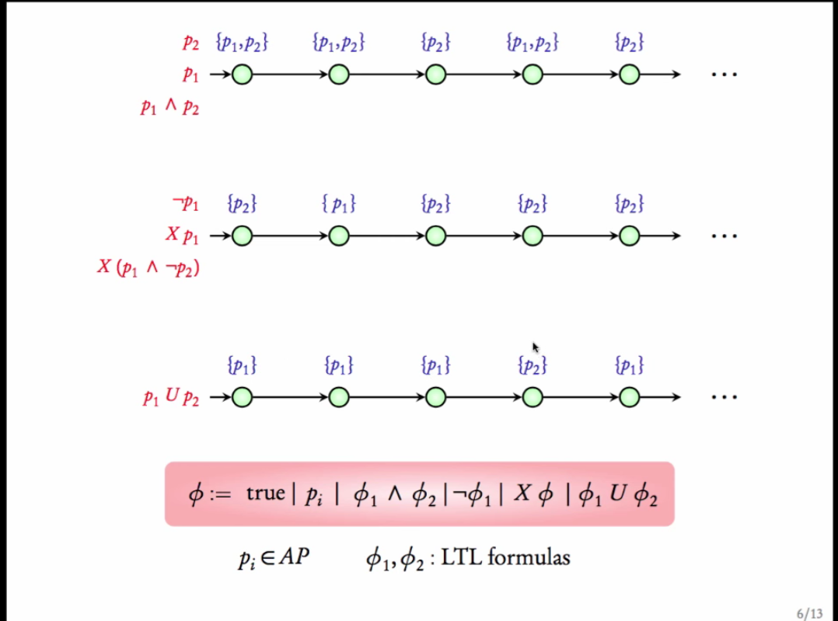
Additional Examples

Slide 88
